Slide 1


St. MARTINS ENGINEERING COLLEGE
UGC Autonomous
NBA & NAAC A+ ACCREDITED
Dhulapally, Secunderabad– 500100
Department of CSE(AI&ML)
FACIAL EXPRESSION RECOGNITION DATASET
A COMPREHENSIVE RESOURCE FOR EMOTION ANALYSIS
Batch No: 05 (TNR-Size 24)
1.T.AKSHITHA (21K81A6655)
2. K.GAYATHRI (21K81A6623)
3. O.PRASHANTH (21K81A6635)
Under the Guidance of
Mr. KRANTHI KUMAR
ASST.PROFESSER
Department of CSE(AI&ML)

Slide 2
OUTLINE
Abstract
Detailed Design
Representational Diagrams
Contribution of the Candidate
Results Obtained
References
80% of Code Implementation

Slide 3
ABSTRACT
Facial emotion analysis has gained significant interest in recent years due to its applications in various fields, including human-computer interaction, security, and psychological studies
These statistics underscore the importance of developing robust and reliable facial emotion analysis systems. Existing manual approaches to facial emotion analysis involve human observers interpreting facial expressions.
These methods are time-consuming and lack consistency, as different observers may interpret the same expression differently. Moreover, manual analysis is not scalable for large datasets or real-time applications.
The inherent biases and limitations of human observers highlight the need for more objective and scalable solutions to facial emotion analysis.
Machine learning (ML) presents a promising solution to the challenges faced by manual approaches. By training models on large datasets of facial expressions

Slide 4
DETAILED DESIGN
Image Preprocessing: This step involves preparing the images for analysis. This may include operations like resizing, normalization, data augmentation, and other techniques to make the data suitable for model training.
Data Splitting: The dataset is split into features (X) and labels (y). Here, the feature set (X) contains the image data, and the label set (y) contains the corresponding targets or classes.
Train/Test Splitting: The data is divided into training and testing sets. The training set is used to train the machine learning model, while the testing set is kept aside to evaluate the model's performance.
Model Building:Two types of models are mentioned: Decision Tree Classifier (DTC) and (CNN).
The models are built using the training data (X_train and y_train).

Slide 5
DETAILED DESIGN
Testing: The test set is used to evaluate the performance of the model. This may involve preprocessing the test data similarly to how the training data was processed.
Prediction: The model makes predictions based on the test data.
Performance Evaluation: The performance of the model is assessed using various metrics:
Accuracy: The overall correctness of the model.
Precision : The accuracy of the positive predictions.
.Confusion Matrix : A matrix to visualize the performance of the model, showing true positives, true negatives, false positives, and false negatives.

Slide 6
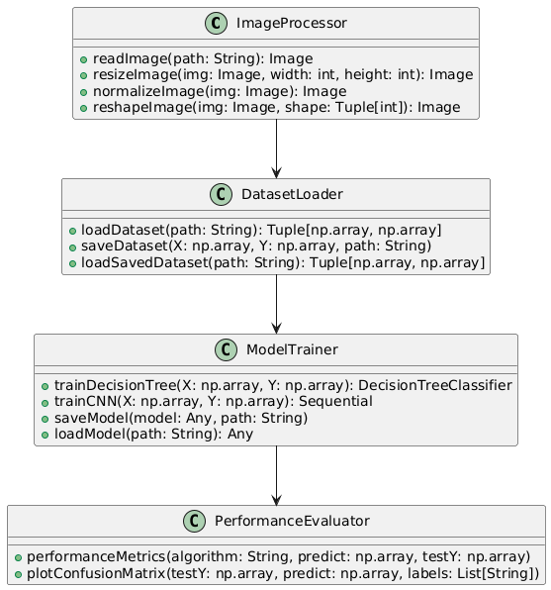
REPRESENTATIONAL DIAGRAM
Class Diagram: Class diagram is a static diagram. It represents the static view of an application

Slide 7
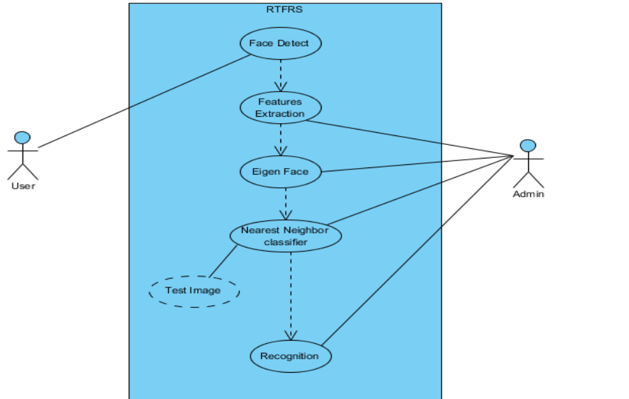
REPRESENTATIONAL DIAGRAM
Usecase diagram: The purpose of use case diagram is to capture the dynamic aspect of a system

Slide 8
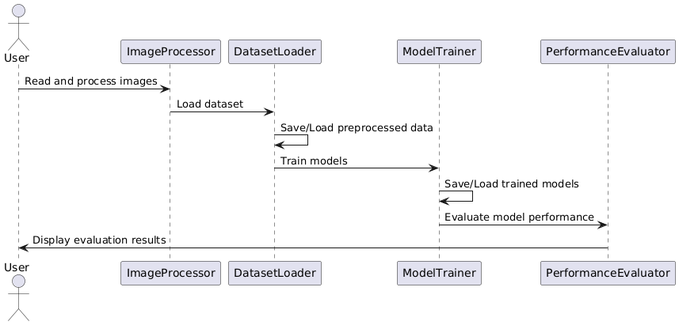
REPRESENTATIONAL DIAGRAM
Sequence Diagram :
A sequence diagram in (UML) is a kind of interaction diagram that shows how processes operate with one another and in what order.

Slide 9
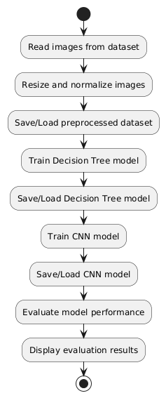
REPRESENTATIONAL DIAGRAM
Activity diagram : Activity diagram is another important diagram in UML to describe the dynamic aspects of the system

Slide 10
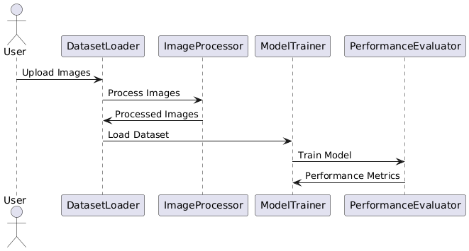
REPRESENTATIONAL DIAGRAM
Data flow diagram:
A data flow diagram (DFD) is a graphical representation of how data moves within an information system.

Slide 11
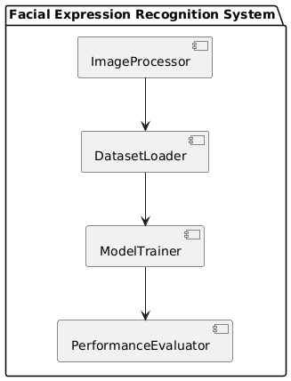
REPRESENTATIONAL DIAGRAM
Component diagram: Component diagram describes the organization and wiring of the physical components in a system

Slide 12
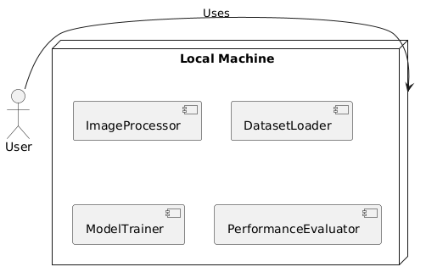
REPRESENTATIONAL DIAGRAM
Deployment diagram : The deployment diagram visualizes the physical hardware on which the software will be deployed.

Slide 13
CONTRIBUTION OF THE CANDIDATE
T .AKSHITHA | K.GAYATHRI | O.PRASHANTH
Project Planning and Coordination | Data Preprocessing | Model Building & Evaluation
Data Acquisition | Data Visualization | Data Balancing
Model Selection and Training | Ethical Considerations | Model Deployment
Documentation and Reporting | Feature Engineering | Cross-Validation

Slide 14
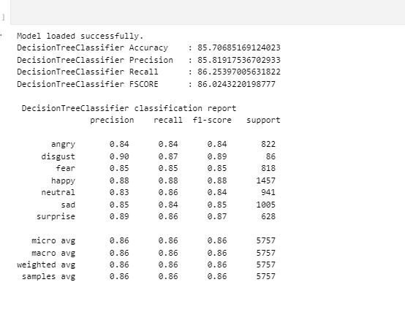
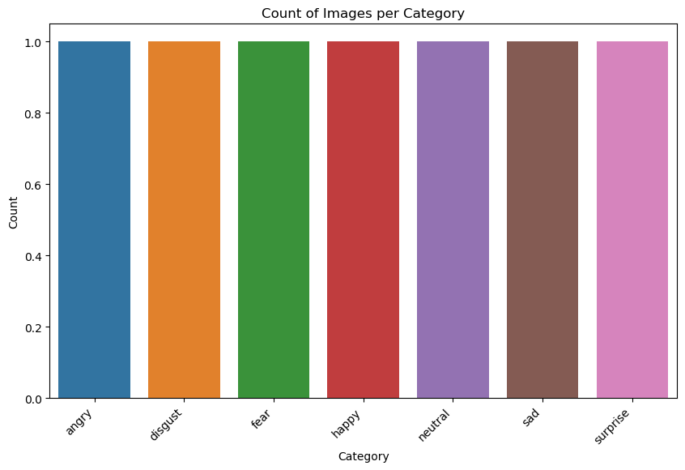
RESULTS OBTAINED

Slide 15
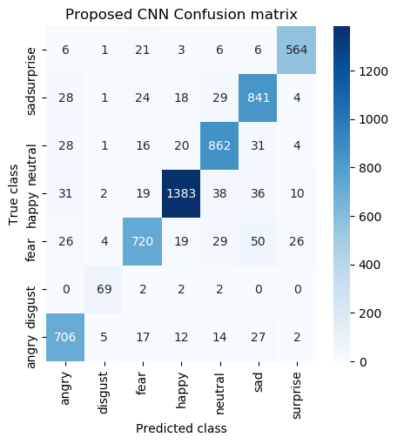
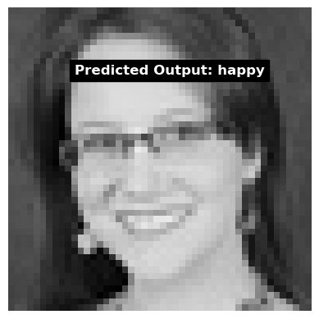
RESULTS OBTAINED

Slide 16
REFERENCES
FER-2013: A Large-Scale Dataset for Facial Emotion Recognition" by J. M. A. De la Torre, T. Zhang, and others (2013)
"Emotion Recognition from Facial Expressions using Deep Learning Techniques" by J. A. Gonzalez, M. S. Gupta, and others (2021)
DeepFace: Closing the Gap to Human-Level Performance in Face Verification" by Yaniv Taigman, Ming Yang, and others (2014)
"Facial Expression Recognition Using Deep Learning" by Y. Liu, M. M. K. Naidu, and others (2019)
A Survey on Facial Emotion Recognition with Deep Learning" by Zhiwei Zhang, Yunchao Wei, and others (2020).

Slide 17
REFERENCES
Mateusz Zarkowski Identification-deiven Emotion Recognition System for a Social Robot IEEE Posted: 2013Crossref 72.
M Pantic, A Pentland, A Nijholt, TSHuang Human computing and machine understanding of human behaviour: a survey, in Artificial Intelligence for Human Computing Lecture, volume 4451
H K Meena, K K Sharma, S D Joshi Improved facial expression recognition using graph signal processing Electronics
TAhsan, T Jabia, U.-P Chong Facial expression recognition using local transitional pattern on Gabor Filtered facial image

Slide 18
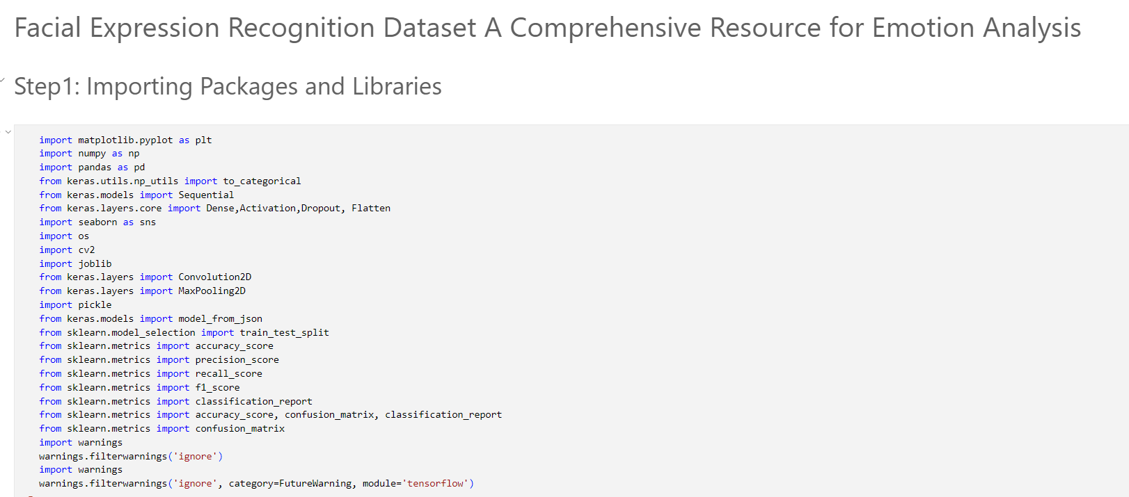
IMPLEMENTATION

Slide 19
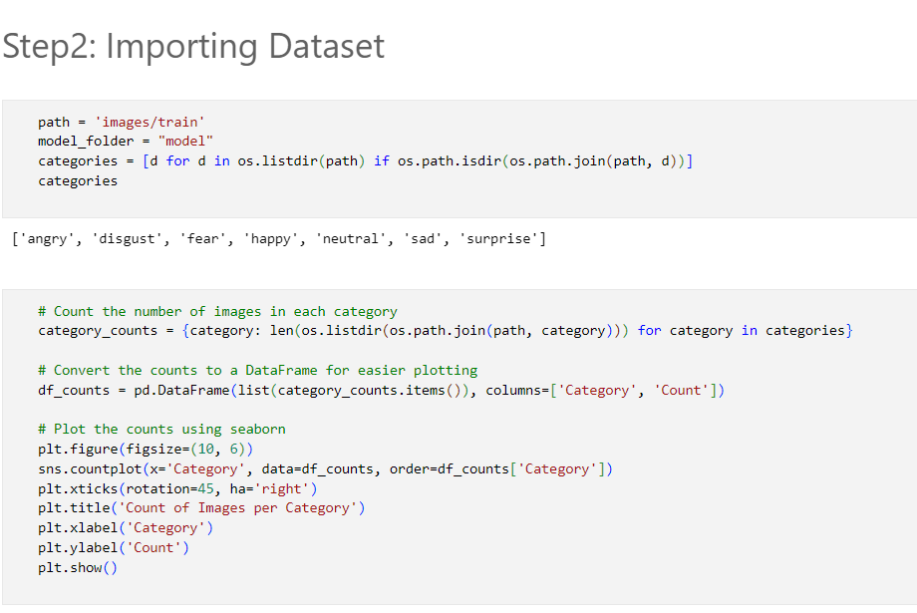
IMPLEMENTATION

Slide 20
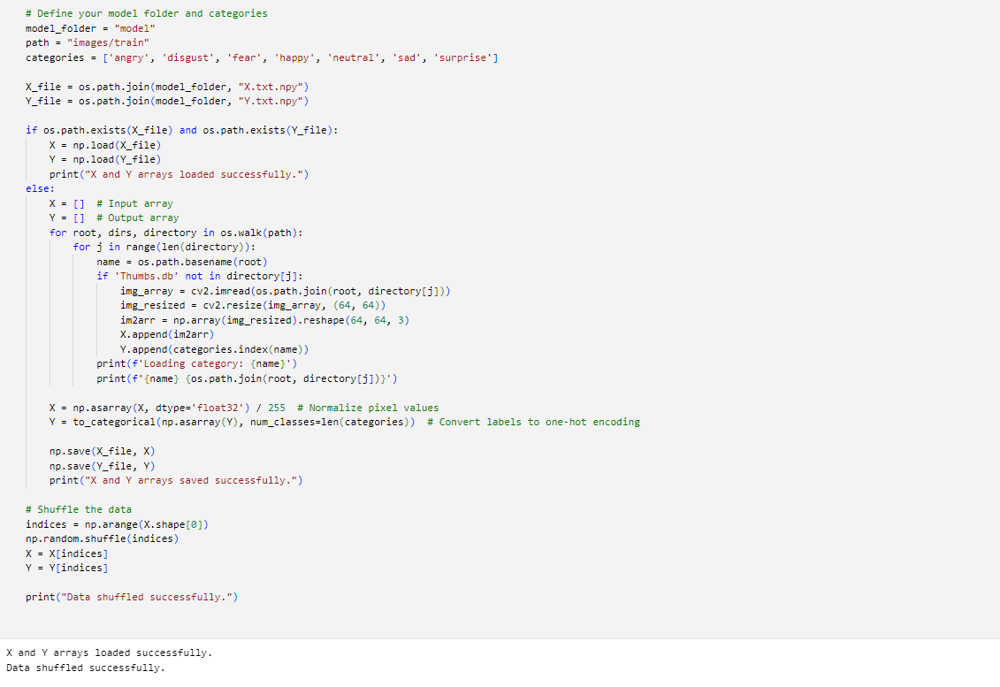
IMPLEMENTATION

Slide 21
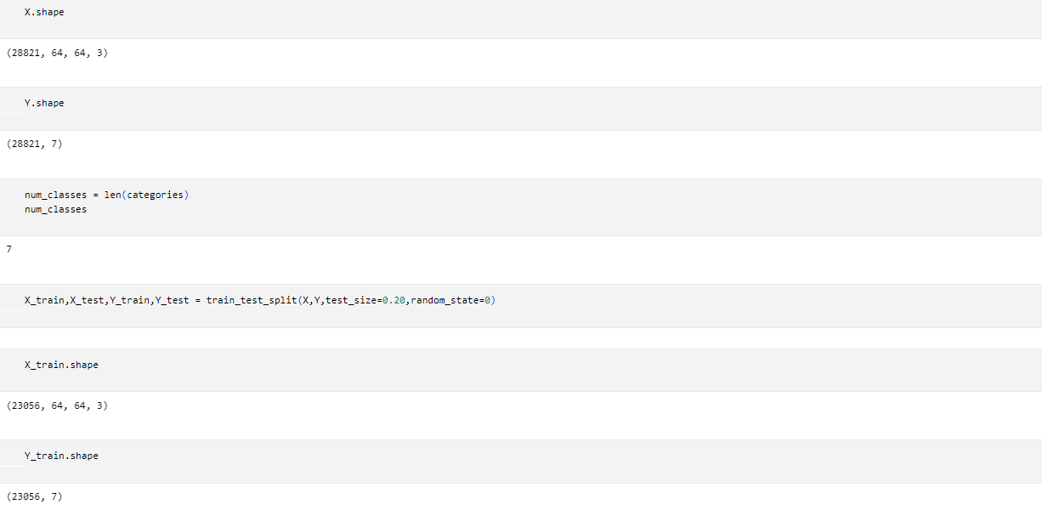
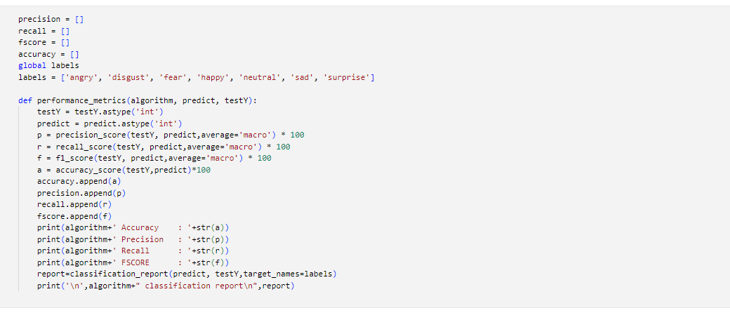
IMPLEMENTATION

Slide 22
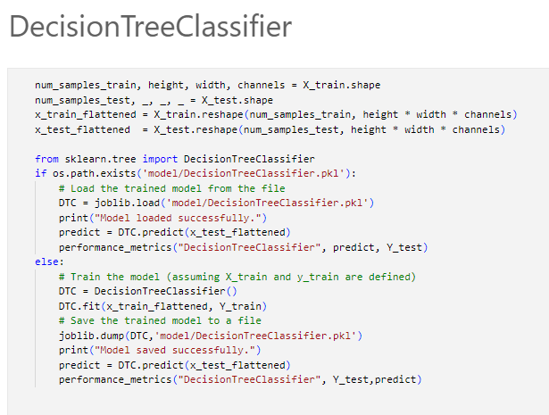
IMPLEMENTATION

Slide 23
THANK YOU

